Slide 1



PREDCTING CUSTOMER SATISFACTION USING MLOPS
BATCH NO: 9
PRESENTED BY:
NAME: ANBUCHELVAN R REG NO: 510421104007
NAME: ARUN KUMAR R REG NO: 510421104010
NAME: BASKARAN C REG NO: 510421104015
NAME: DHANUSH A REG NO: 510421104023
GUIDED BY : Mrs. S. LALITHA, M.Tech, AP,CSE
DEPARTMENT OF CSE 14/05/2025

Slide 2
AGENDA
CS3811-PROJECT WORK
Abstract
Introduction
Problem Statement
Literature Survey
Extract of Literature Survey
Existing System
Proposed System
Methodology
Tools and Technologies
System Architecture
Module Description
Implementation
Challenges and Limitations
Future scope
References
Conclusion
DEPARTMENT OF CSE 14/05/2025

Slide 3
CS3811-PROJECT WORK
ABSTRACT
Customer satisfaction plays a crucial role in the success of any business, especially in e-commerce. Traditional methods like surveys and manual feedback analysis are slow and often inaccurate, making it difficult to understand customer feelings in real-time. This project aims to predict how satisfied a customer will be with their next purchase using Machine Learning (ML) and MLOps. Using the E-Commerce Public Dataset, which includes details about orders, payments, deliveries, and customer reviews, we build a model to estimate customer satisfaction scores. By using MLOps, we automate the process of training, deploying, and monitoring the model, ensuring it stays accurate over time. This approach provides real-time insights, helping businesses respond to customer needs quickly and effectively. It also supports better decision-making, reduces customer churn, and improves overall customer experience.
DEPARTMENT OF CSE 14/05/2025

Slide 4
CS3811-PROJECT WORK
INTRODUCTION
In today’s fast-evolving digital commerce landscape, customer reviews play a pivotal role in shaping purchasing decisions and brand perception. With the increasing volume of online feedback, manual analysis has become impractical and inefficient. This project proposes an automated sentiment analysis system designed to classify customer reviews into positive, neutral, or negative categories using Natural Language Processing and Machine Learning techniques. The system not only stores each review along with its sentiment label and confidence score in a MongoDB database but also triggers a personalized email response when a negative sentiment is detected. By combining intelligent classification with automated engagement, the solution ensures that customer grievances are promptly addressed, thereby fostering trust, improving satisfaction, and streamlining business communication workflows.
DEPARTMENT OF CSE 14/05/2025

Slide 5
CS3811-PROJECT WORK
PROBLEM STATEMENT
Businesses receive large volumes of unstructured customer feedback through reviews, emails, and social media platforms.
Manual analysis of this data is time-consuming, error-prone, and lacks consistency in sentiment interpretation.
Traditional survey-based satisfaction methods fail to capture spontaneous or real-time customer sentiments.
Existing sentiment analysis systems often lack automation, real-time processing, and integration with operational workflows.
There is a need for a scalable, intelligent solution that can:
Accurately classify customer sentiments (positive, neutral, negative),
Trigger timely actions based on feedback,
And support continuous improvement through automated monitoring and retraining.
DEPARTMENT OF CSE 14/05/2025

Slide 6
LITERATURE SURVEY
2012 – “Sentiment Analysis and Opinion Mining” by Bing Liu:
A foundational paper discussing various supervised learning methods for sentiment extraction from textual data.
2016 – “A Survey on Sentiment Analysis and Opinion Mining” by S. Poria et al.:
Provides an overview of sentiment analysis methods and their significance in business and customer feedback applications.
2018 – “Sentiment Analysis Using Deep Learning: A Survey” by Y. Zhang et al.:
Highlights the application of deep learning techniques, especially CNNs and LSTMs, in managing large-scale sentiment data.
2020 – “MLOps: Machine Learning Operations” by G. V. Smith et al.:
Discusses the MLOps framework for automating deployment, monitoring, and management of ML models in production.
2021 – “Real-time Sentiment Analysis of Social Media Posts Using Machine Learning” by A. Gupta et al.:
Focuses on tools and frameworks for real-time sentiment monitoring to assess customer satisfaction in social media.
DEPARTMENT OF CSE 14/05/2025

Slide 7
EXTRACT OF LITERATURE SURVEY
The foundational work by Bing Liu (2012) introduced core methodologies for sentiment classification, which inspired the use of supervised learning models in our system to categorize customer reviews into positive, neutral, or negative sentiments.
The 2016 survey by S. Poria et al. emphasized real-world applications of sentiment analysis, guiding our focus on business-driven sentiment detection, especially for actionable insights in customer feedback.
Drawing from Y. Zhang et al. (2018), we incorporated deep learning techniques, particularly CNNs and LSTMs, as a basis for enhancing model accuracy and effectively handling large volumes of unstructured review data.
Inspired by G. V. Smith et al. (2020), our architecture integrates MLOps principles to enable automated deployment and management of our sentiment analysis model, ensuring scalability and continuous improvement in a production setting.
The study by A. Gupta et al. (2021) influenced our decision to integrate real-time sentiment tracking and MongoDB for live storage, enabling the system to log sentiment data with confidence scores and trigger personalized email alerts for negative sentiments.
DEPARTMENT OF CSE 14/05/2025

Slide 8
CS3811-PROJECT WORK
EXISTING SYSTEM
Traditional systems rely heavily on survey-based metrics like Net Promoter Score (NPS) or periodic feedback, which are limited in real-time applicability. Many sentiment analysis tools operate in batch mode with minimal integration into business operations. Current drawbacks include:
Limited real-time data processing
Manual model retraining and updates
Inaccurate sentiment detection in ambiguous language
Lack of integration with business processes
Absence of automated monitoring and scalability
DEPARTMENT OF CSE 14/05/2025

Slide 9
CS3811-PROJECT WORK
PROPOSED SYSTEM
The proposed system automates customer sentiment analysis and proactive engagement based on product reviews. It operates in several core stages:
Sentiment Classification
      Customer reviews are preprocessed and vectorized using TF-IDF.
  A Random Forest Classifier predicts the sentiment as Positive, Neutral, or Negative, alongside a confidence score.
Database Storage
Each review is stored in a MongoDB database with fields including:
Review_Text, Sentiment_Label, Confidence_Score, E-mail ID.
Automated Response System
  Reviews with Negative sentiment and confidence >80% trigger an automated, personalized email to the customer.
  Emails express concern and offer solutions, enhancing customer care.
End-to-End Automation
  Integrated into an MLOps pipeline for seamless automation, monitoring, and periodic model retraining.
DEPARTMENT OF CSE 14/05/2025

Slide 10
CS3811-PROJECT WORK
METHODOLOGY
1. Data Collection
Customer reviews are gathered from various sources such as surveys, product feedback forms, and e-commerce platforms.
2. Data Preprocessing
Text data is cleaned by removing stopwords, punctuation, and irrelevant symbols. Tokenization and normalization are applied.
3. Feature Extraction
TF-IDF vectorization is used to convert preprocessed text into numerical feature vectors suitable for machine learning.
4. Model Training
A Random Forest Classifier is trained on labeled sentiment data (positive, neutral, negative) to learn classification patterns.
5. Sentiment Prediction
The trained model predicts the sentiment of new customer feedback in real time with a confidence score.
6. Database Storage
Feedback, sentiment labels, and confidence scores are stored in MongoDB for analysis and future retraining.
7. Alert Notification
If negative sentiment is detected, an automated personalized email alert is triggered to customer support.
8. MLOps Pipeline
Continuous integration and monitoring are implemented using MLflow to ensure model versioning, retraining, and production stability.
DEPARTMENT OF CSE 14/05/2025

Slide 11
CS3811-PROJECT WORK
TOOLS AND TECHNOLOGIES
Programming Language: Python
Web Framework: Flask (Backend), HTML/CSS (Frontend)
Natural Language Processing: NLTK, Scikit-learn, TF-IDF Vectorization
Machine Learning Algorithm: Random Forest Classifier
Database: MongoDB (NoSQL for storing sentiment-labeled reviews)
Model Monitoring & Deployment: MLflow, GitHub Actions (CI/CD)
Data Versioning: DVC (Data Version Control)
Visualization & Reporting: Matplotlib, Seaborn
Email Automation: SMTP (Python smtplib) for alert notifications
Development Environment: Jupyter Notebook, VS Code
Deployment: Localhost (test) with cloud-ready Docker support
DEPARTMENT OF CSE 14/05/2025

Slide 12
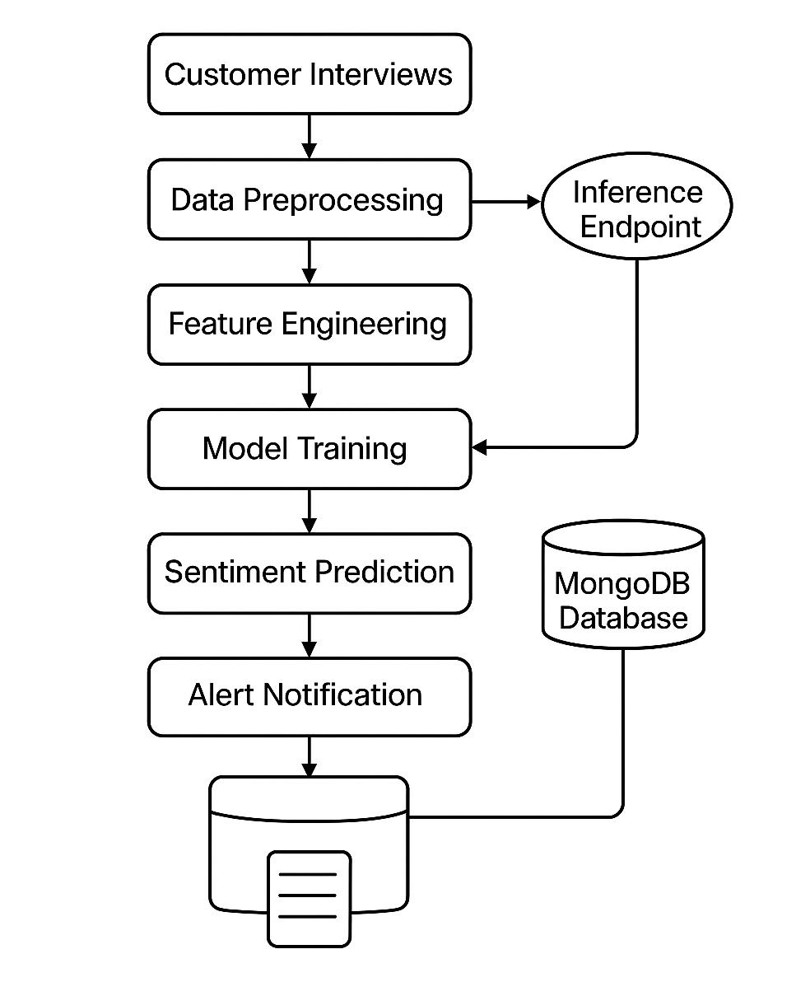
CS3811-PROJECT WORK
SYSTEM ARCHITECTURE
DEPARTMENT OF CSE 14/05/2025

Slide 13
CS3811-PROJECT WORK
MODULE DESCRIPTION
1. Data Collection Module
  Aggregates customer reviews and sentiment-rich feedback from diverse e-commerce sources such as Amazon and Flipkart.
  Employs web scraping tools and REST APIs for automated, scalable, and real-time data extraction.
  Ensures the collected data spans multiple product categories and customer opinions for broader generalization.
2. Data Preprocessing Module
        Cleanses and standardizes raw textual data to enhance model input quality.
        Performs operations including:
          Removal of stopwords, special characters, and irrelevant HTML tags
          Handling of missing data and noisy entries
        Outputs a refined and machine-readable dataset for reliable feature extraction.
DEPARTMENT OF CSE 14/05/2025

Slide 14
CS3811-PROJECT WORK
MODULE DESCRIPTION
3. Feature Extraction Module
    Transforms cleaned text into numerical representations using NLP techniques:
      Tokenization to split sentences into words
      Sentiment lexicon mapping to associate words with polarity scores
      Vectorization using methods like TF-IDF and Word2Vec for contextual relevance
    Extracts domain-specific sentiment patterns and encodes them as feature vectors for model input.
  4. Model Training Module
    Implements supervised machine learning algorithms for sentiment classification:
      Random Forest: Robust ensemble classifier resistant to overfitting
      SVM (Support Vector Machine): High-performance binary classifier for text sentiment separation
      BERT: Transformer-based deep learning model capturing contextual dependencies
    Trains and validates models on 1000+ labelled customer reviews for optimized accuracy.
DEPARTMENT OF CSE 14/05/2025

Slide 15
CS3811-PROJECT WORK
MODULE DESCRIPTION
5. Sentiment Prediction Module
  Deploys trained models to classify incoming feedback in real time as Positive, Negative, or Neutral.
  Ensures dynamic updates and response generation for continuous customer feedback analysis.
  Supports integration with live user interfaces or feedback dashboards for actionable insights.
6. MLOps Pipeline Module
        Orchestrates the end-to-end lifecycle from model training to deployment.
        Enables continuous integration and delivery (CI/CD) with automatic retraining upon data drift detection.
        Incorporates model versioning, monitoring, and logging for reliability and reproducibility.
        Streamlines production workflows ensuring scalable and maintainable sentiment analysis infrastructure.
DEPARTMENT OF CSE 14/05/2025

Slide 16
CS3811-PROJECT WORK
IMPLEMENTATION
The proposed sentiment analysis system has been meticulously implemented using a modular architecture integrated with an automated MLOps pipeline. The implementation focuses on robust data processing, efficient sentiment classification, and real-time feedback handling. The system is designed to handle diverse customer reviews and dynamically adapt to new data inputs.
Main Features of the Implementation:
              Real-time Sentiment Prediction
              New customer feedback is instantly classified into positive, neutral, or negative categories.
              Negative Sentiment Alert System
              Automatically sends personalized email alerts to customer support when negative sentiment is detected.
              MongoDB Integration
              Stores customer reviews along with sentiment labels and confidence scores in a structured NoSQL database.
              Scalable MLOps Pipeline
              Automates model deployment, retraining, and monitoring using CI/CD principles for reliable production performance.
DEPARTMENT OF CSE 14/05/2025

Slide 17
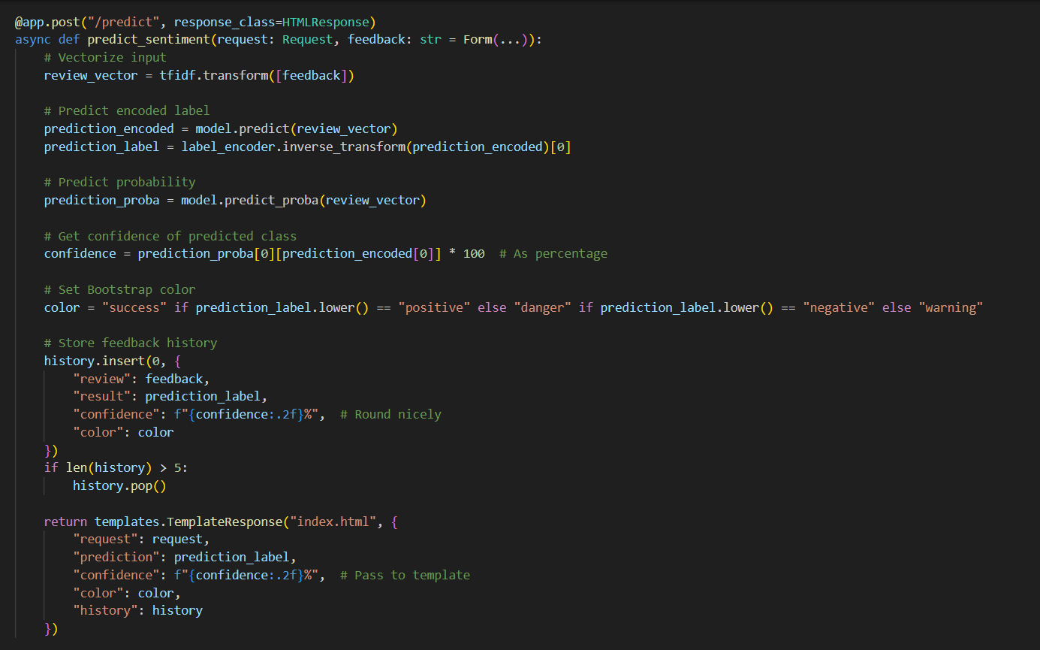
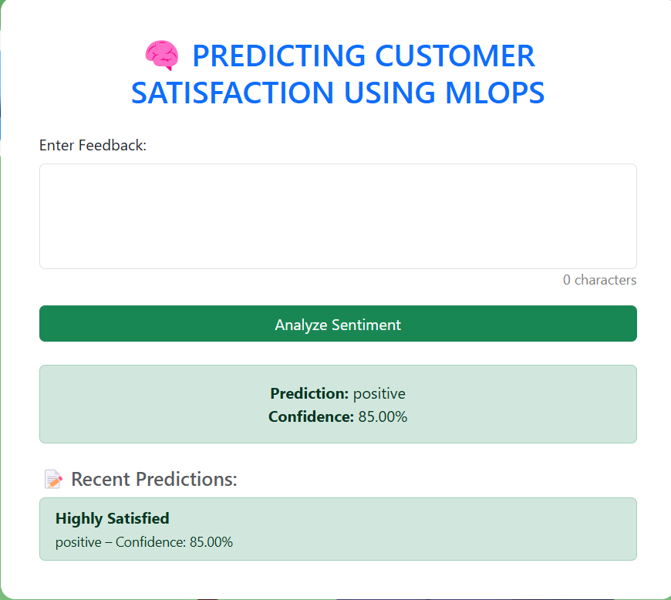
CS3811-PROJECT WORK
IMPLEMENTATION
              Real-time Sentiment Prediction
DEPARTMENT OF CSE 14/05/2025

Slide 18
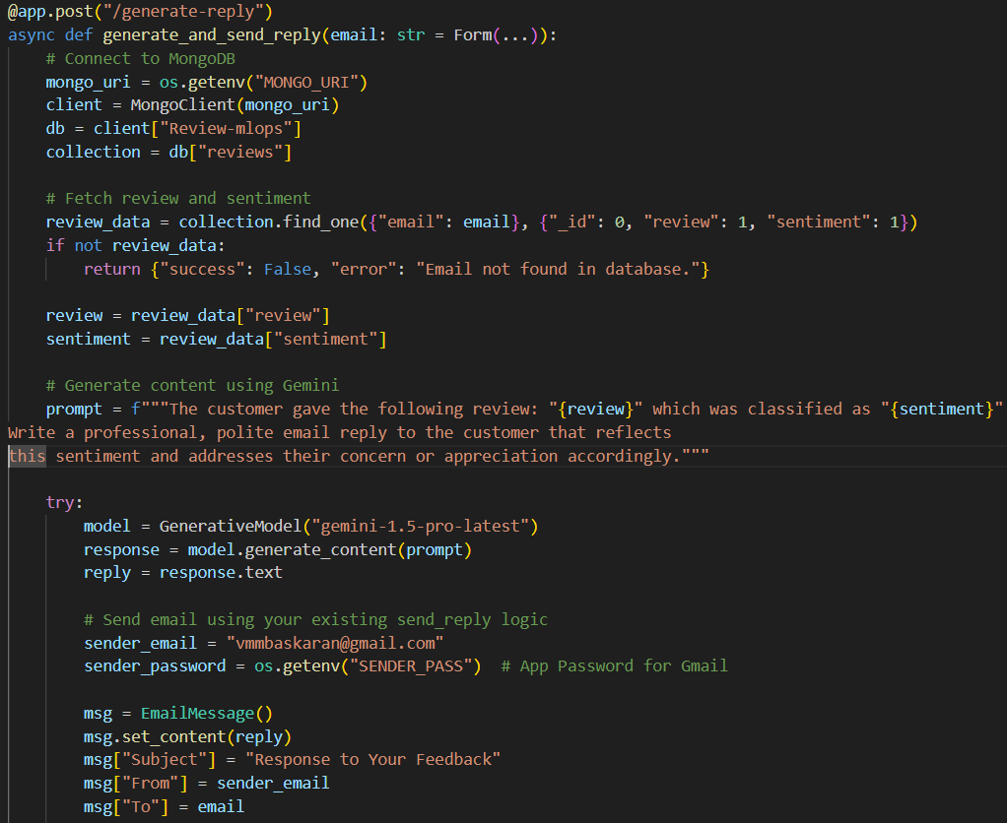
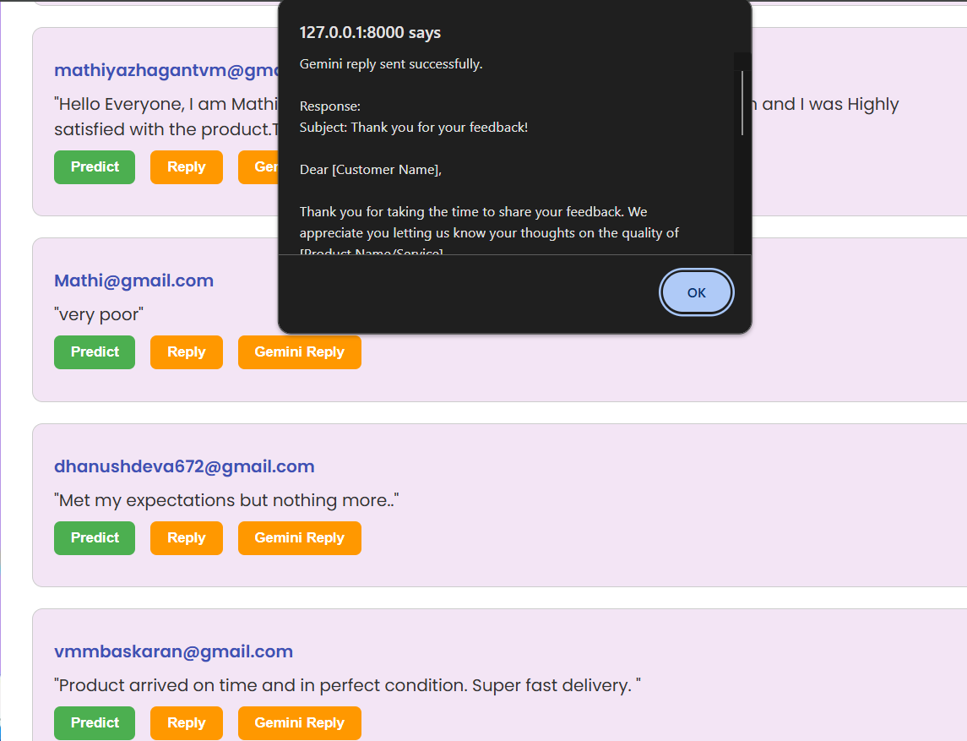
CS3811-PROJECT WORK
IMPLEMENTATION
              Personalized mail System
DEPARTMENT OF CSE 14/05/2025

Slide 19
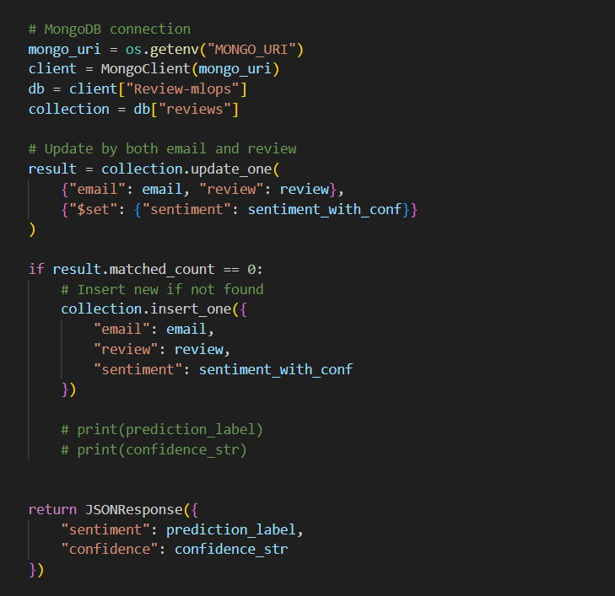
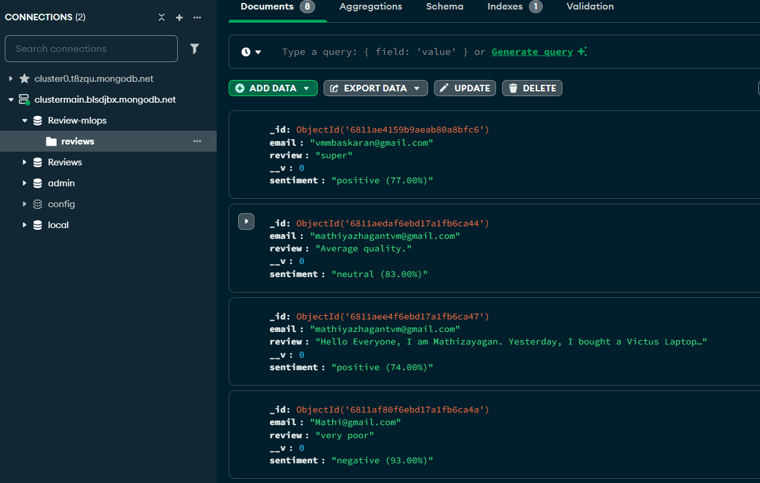
CS3811-PROJECT WORK
IMPLEMENTATION
              MongoDB Integration
DEPARTMENT OF CSE 14/05/2025

Slide 20
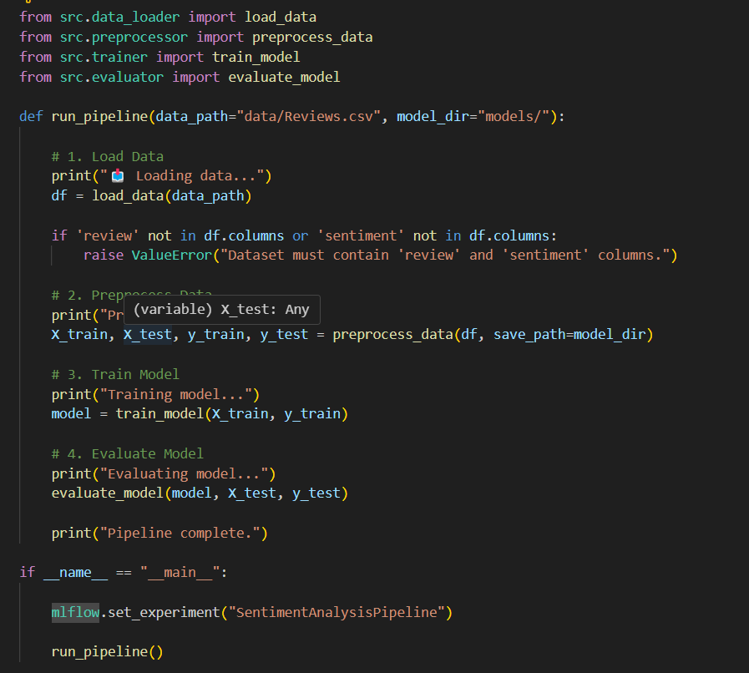
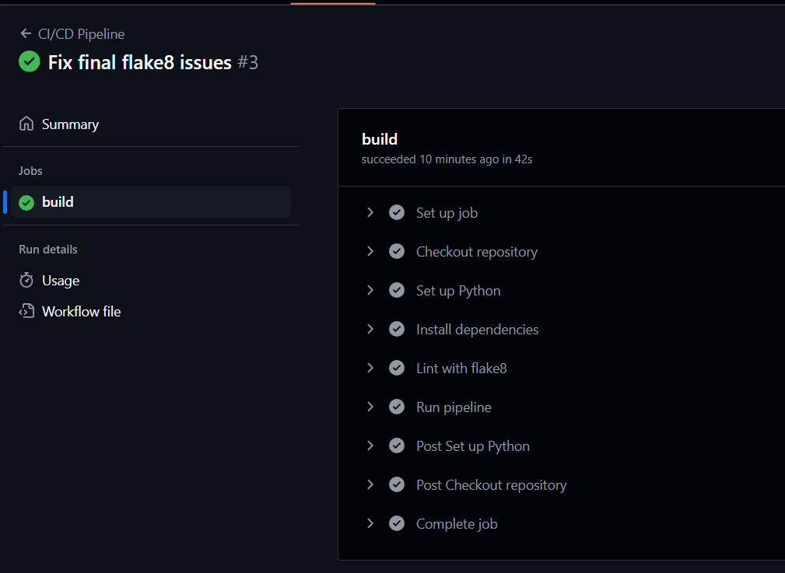
CS3811-PROJECT WORK
IMPLEMENTATION
              Scalable MLOps Pipeline:
DEPARTMENT OF CSE 14/05/2025

Slide 21
CS3811-PROJECT WORK
FUTURE SCOPE
Multilingual Sentiment Analysis
Expand support for regional and international languages to analyze a diverse range of customer feedback.
Aspect-Based Sentiment Analysis (ABSA)
Identify sentiments for specific product or service aspects (e.g., delivery, quality, pricing) for targeted improvement.
Sarcasm and Emotion Detection
Enhance model accuracy by incorporating sarcasm handling and emotion classification using deep learning models.
Voice and Video Feedback Integration
Extend feedback input modes to include voice and video, enabling analysis through speech-to-text and visual sentiment cues.
CRM and Chatbot Integration
Seamlessly connect with Customer Relationship Management systems and AI chatbots for automated support actions.
Predictive Analytics for Customer Retention
Use sentiment trends to predict churn risk and recommend retention strategies.
DEPARTMENT OF CSE 14/05/2025

Slide 22
CS3811-PROJECT WORK
REFERENCES
[1] Liu, B. (2012). Sentiment Analysis and Opinion Mining. Morgan & Claypool Publishers.
[2] Poria, S., Cambria, E., & Gelbukh, A. (2016). A Survey on Sentiment Analysis and Opinion Mining. ACM Computing Surveys.
[3] Zhang, Y., et al. (2018). Sentiment Analysis Using Deep Learning: A Survey. IEEE Transactions on Affective Computing.
[4] Smith, G. V., et al. (2020). MLOps: Machine Learning Operations. Journal of Big Data.
[5] Gupta, A., et al. (2021). Real-time Sentiment Analysis of Social Media Posts Using Machine Learning. International Journal of Computer Applications.
DEPARTMENT OF CSE 14/05/2025

Slide 23
CS3811-PROJECT WORK
CONCLUSION
The proposed sentiment analysis system effectively addresses the growing need for intelligent customer feedback interpretation. By leveraging advanced natural language processing techniques and robust machine learning models like Random Forest, the system accurately classifies customer sentiments as positive, neutral, or negative. The integration with MongoDB ensures seamless storage and retrieval of classified reviews, while the automated email alert mechanism enhances customer service by enabling timely responses to dissatisfied users. Furthermore, the incorporation of an MLOps pipeline ensures continuous improvement, scalability, and reliable deployment of models in real-world scenarios. Overall, the system offers a practical, efficient, and scalable solution for businesses aiming to monitor and enhance customer satisfaction in a data-driven manner.
DEPARTMENT OF CSE 14/05/2025

Slide 24
CS3811-PROJECT WORK
THANK YOU
DEPARTMENT OF CSE 14/05/2025

